Slide 1
What Makes
People Laugh?
Zihan Zhang
(zihan.zhang3@dukekunshan.edu.cn)

Slide 2

Problem Description
Problem description
  In standing comedy, a performer delivers jokes to trigger laughter from the live audience. A successful joke is often evaluated by the audience’s laughter.
  While humor research has extensively examined jokes in cultural, linguistic and social aspects, less attention has been given to the acoustic delivery of the speaker and its relationship with audience laughter responses.
Beyond what is said, how does the way saying influence laughter?
  Psychological: emotion and humor delivery in communication
  Practical: tailor vocal strategies to achieve expected laughter effect
The purpose for the project
  Build a machine learning model that can detect laughter segments in standing comedy recordings using acoustic features
  Study the relationship between acoustic features of speakers and audience laughter outcomes

Slide 3
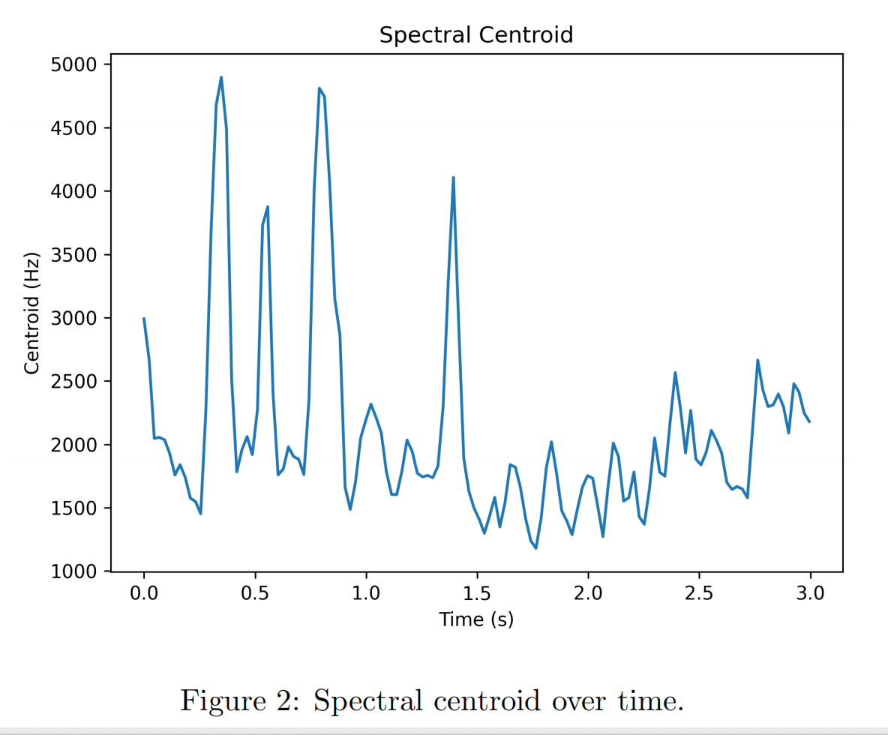

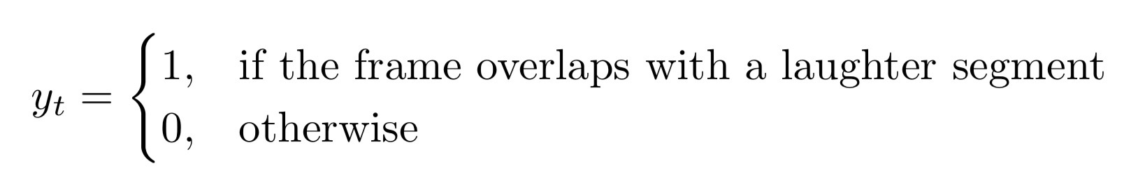
Data & Preprocessing
1. 244 standing comedy videos (converted into .wav format), 30 videos are randomly selected to build the model
2. For the first minute of the selected recordings, manually label the start and end timestamps of laughter segments
3. Convert time-based labels into frame-level labels
(1) Formula: frame index= (time × sr)/(hop length)
sr: sampling rate -- the number of samples per second
hop length = 512 (i.e., frames are spaced every 512 samples)
(2) Every frame is classified into 1 = laughter, 0 = non-laughter
4. Parameters for modeling: RMS (loudness), ZCR (noisiness), Centroid (tone color), Delta RMS (stability of loudness), Delta Centroid (fluctuation of tone color), Flux (fluctuation of noisiness)--standardized

Slide 4
Method
24 training, 6 testing
Training:
(1) 4 Classifiers: Logistic Regression, KNN, Decision Tree, Random Forest
(2) Hyperparameter Selection: 5-cross-validation, CV ROC-AUC (class imbalance)
Testing (Evaluation): Test AUC, F1-score
Models / Performance | CV AUC | Test AUC | F1-score | Precision | Recall
Logistic Regression (‘C’: 46.42) | 0.6386 | 0.6489 | 0.3561 | 0.2372 | 0.7141
KNN (‘n-neighbors’: 196) | 0.7583 | 0.7124 | 0.2544 | 0.5005 | 0.1706
Decision Tree (‘max_depth’: 10) | 0.7344 | 0.6994 | 0.4032 | 0.2905 | 0.6211
Random Forest (‘max_depth’: 10) | 0.7609 | 0.7161 | 0.4166 | 0.3213 | 0.5921

Slide 5
Model Selection
Models / Performance | CV AUC | Test AUC | F1-score | Precision | Recall
Logistic Regression (‘C’: 46.42) | 0.6386 | 0.6489 | 0.3561 | 0.2372 | 0.7141
KNN (‘n-neighbors’: 196) | 0.7583 | 0.7124 | 0.2544 | 0.5005 | 0.1706
Decision Tree (‘max_depth’: 10) | 0.7344 | 0.6994 | 0.4032 | 0.2905 | 0.6211
Random Forest (‘max_depth’: 10) | 0.7609 | 0.7161 | 0.4166 | 0.3213 | 0.5921
Non-linear models show stronger discriminative ability, but may overfit
(drop from CV AUC to Test AUC--KNN: 0.046, Decision Tree: 0.035, Random Forest: 0.045)
Random Forest is selected:
(1) Highest CV AUC--strongest discriminative ability in training
(2) Highest Test AUC--best generalization ability
(3) Highest F1-score--balance between precision and recall

Slide 6
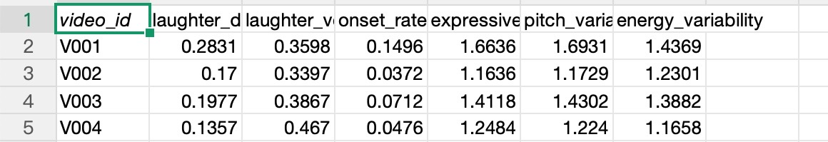
Method
Laughter Detection
1. Apply the trained model to full dataset (244) to detect laughter for every frame (frame labels: 1 = laughter frame, 0 = non-laughter--speaker frame)
2. Feature Extraction -- csv
Laughter Feature (response):
(1) laughter duration(sec) -- mean duration of every laughter segments (continuous frames)
(2) laughter volume(dB) -- mean volume of laughter frames
Speaker Feature (predictors):
(1) Onset Rate -- rhythmic activity
(2) Pitch Variability -- intonation variation
(3) Energy Variability -- loudness variation
(4) Expressiveness -- variation of tone color

Slide 7
Method
Analysis of Speaker-Laughter Relationship
VIF:
onset rate: 14
expressiveness: 981
pitch variability: 1007
energy variablity: 171
1. OLS regression -- linear relationship between 4 speaker predictors (onset rate, expressiveness, pitch variability, energy variability) and laughter outcomes
2. Lasso regression -- shrink unstable coefficients
3. PCA -- transform predictors into orthogonal compoenents to reveal latent acoustic dimensions
Substantially exceed threshold (VIF = 10)
Severe multicollinearity

Slide 8
Final Results -- OLS
Laughter duration
Model:
F(4, 239) = 95.87, p < 0.001, R² = 0.616 (adjusted R² = 0.610)
(1) Statistically significant (p < 0.001)
(2) Explain 61.6% of the variance in laughter duration
Predictors:
(1) onset rate -- significant negative predictor (β = −0.295, t = -2.07, p = 0.039)
(2) expressiveness, energy variability, pitch variability -- significant positive predictors
energy variability: β = 0.193, t = 6.99, p < 0.001
expressiveness: β = 0.138, t = 2.73, p = 0.007
pitch variability: β = 0.018, t = 2.21, p = 0.028
Laughter volume
Model:
F(4, 239) = 65.42, p < 0.001, R² = 0.523 (adjusted R² = 0.515)
(1) Statistically significant (p < 0.001)
(2) Explain 52.3% of the variance in laughter duration
Predictors:
(1) pitch variability -- significant positive relationship (β = 0.460, t = 3.91, p < 0.001)
(2) energy variability -- significant negative predictor (β = -0.897, t = -14.72, p < 0.001)
(3) onset rate (p = 0.718) and expressiveness (p = 0.123) -- not significant predictors

Slide 9
Final Results -- Lasso
Laughter duration
Best α = 0.00087, R² = 0.613
Coefficients of predictors:
onset rate: -0.003*, expressiveness: 0.019, pitch variability: 0.011, energy variabiity: 0.019
Coefficient of onset rate is substantially shrunk, approaching zero, suggesting its contribution may depend on other predictors.
Laughter volume
Best α = 0.00088, R² = 0.522
Coefficients of predictors:
onset rate: -0.001*, expressiveness: 0.002*, pitch variability: 0.065, energy variabiity: -0.094
Coefficient of onset rate and expressiveness approach zero, showing their contribution may depend on other predictors.

Slide 10
Final Results -- PCA
The first principal component (PC1) accounted for 79.31% of the total variance
The second principal component (PC2) accounted for an additional 11.75%
PC1 loadings:
onset rate:0.495, expressiveness: 0.520, pitch variability: 0.536, energy variability: 0.444
Interpretation: PC1 is a dimension characterized by simultaneous increases in rhythmic activity, expressiveness, pitch variance and volume variance.
PC2 loadings:
onset rate: -0.125, expressiveness: -0.302, pitch variability: -0.327, energy variability: 0.887
Interpretation: PC2 is a dimension characterized by fluctuations in loudness with stable pitch, tone color and rythmic activity

Slide 11
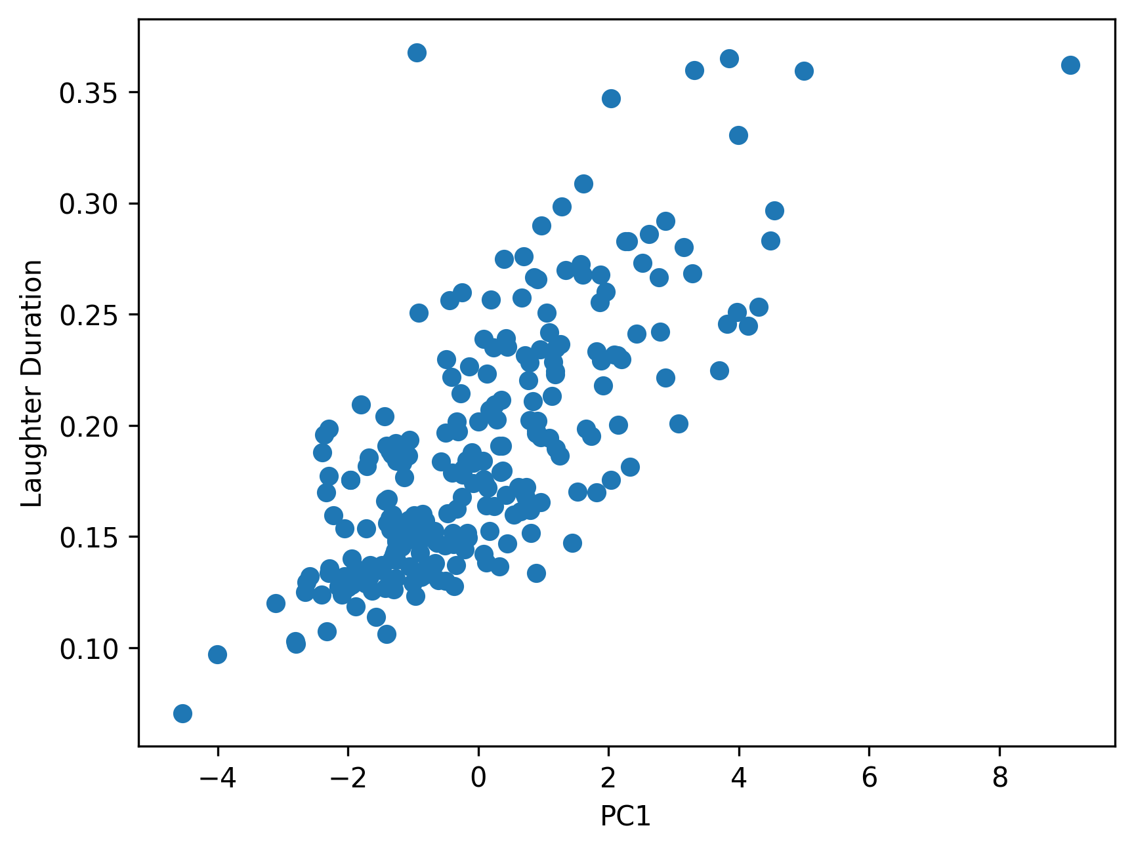
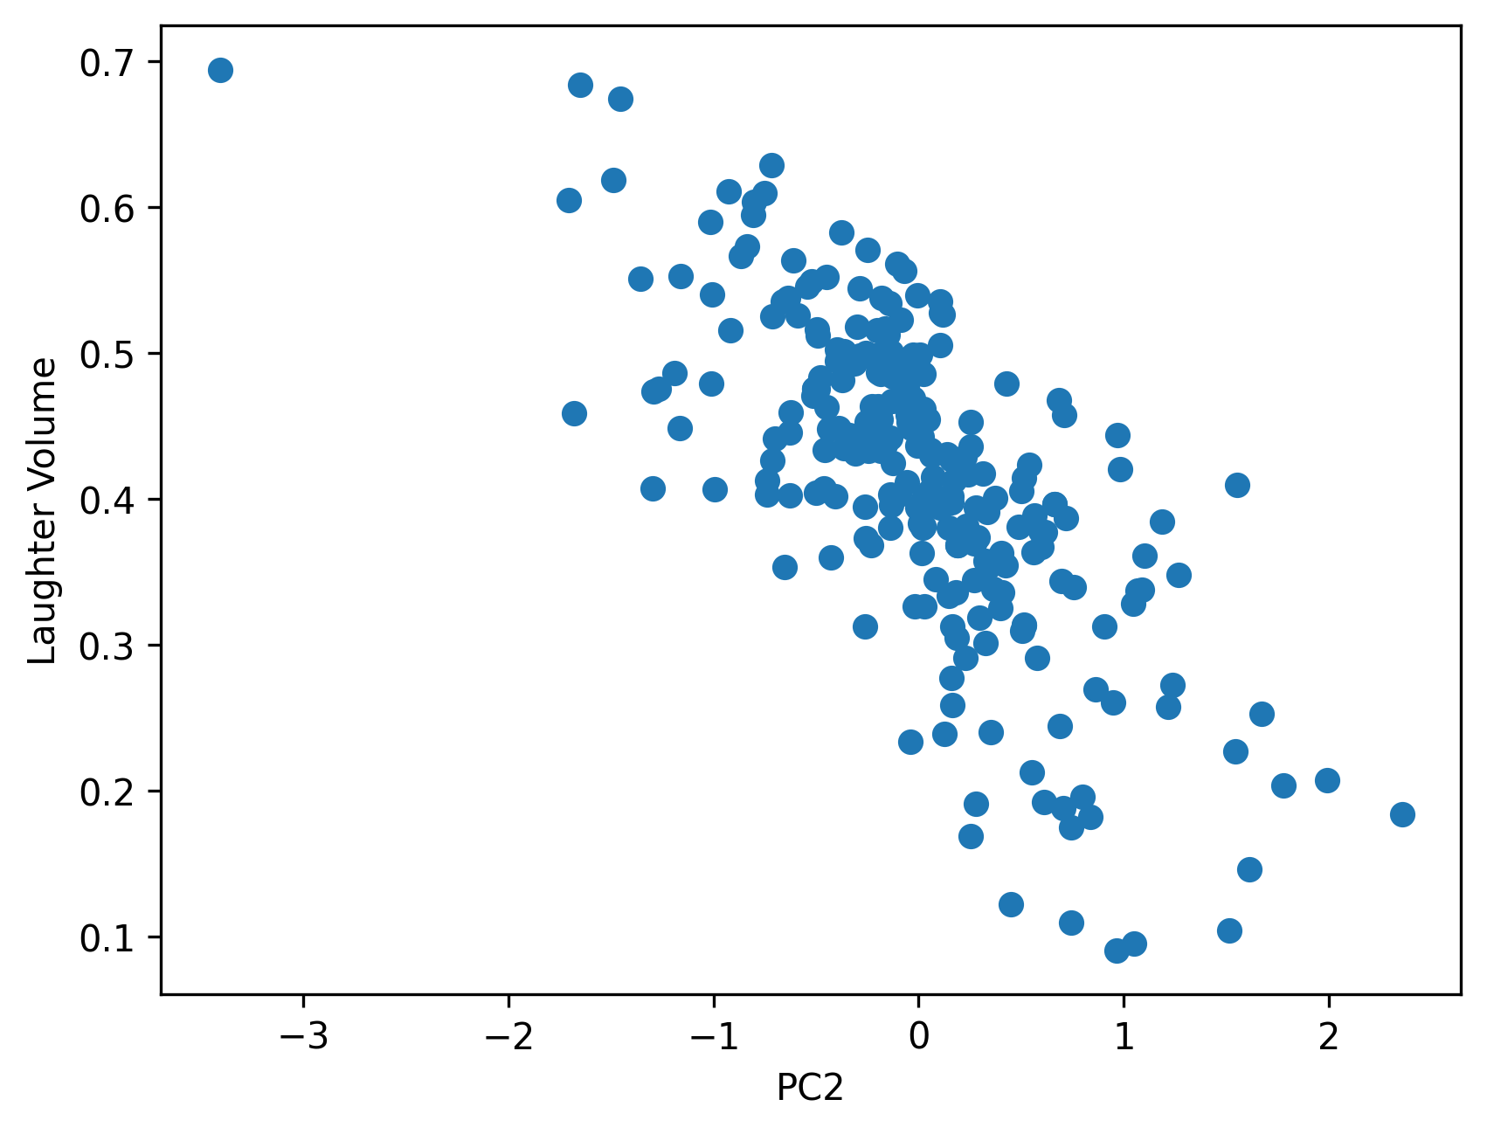
Final Results -- PCA
Figure1: Relationship between PC1 and Laughter Duration
Laughter duration
OLS regression result using PC1 as the predictor: F(1, 242) = 306.50, p < 0.001, R² = 0.559
Interpretation:
(1) PC1 significantly predicts laughter duration (p < 0.001) with positive coefficient (β = 0.023).
(2) Longer laughter episodes are associated with higher overall fluctuations in rhythmic activity, tone color, pitch and loudness.
Laughter volume
PC1 does not significantly predict laughter volume (p = 0.248), but PC2 does.
OLS regression result using PC2 as the predictor: F(1, 242) = 253.00, p < 0.001, R² = 0.511
Interpretation:
(1) PC2 significantly predicts laughter volume (p < 0.001) with negative coefficient (β = -0.115).
(2) Louder laughter is associated with stable loudness but fluctuated rythmic activity, pitch and tone color of speakers.
Figure2: Relationship between PC2 and Laughter Volume

Slide 12
Discussion
Findings:
(1) Higher acoustic activity of speakers—stronger rhythm, richer expressiveness, greater pitch and loudness variance tend to trigger longer laughter episodes.
(2) Speakers who maintain stable volume but vary their pitch, rhythm and tone color tend to trigger louder laughter. The impact of rhythm and tone color may be less significant.
Contributions:
(1) Guidance on vocal delivery strategies for stand-up comedians
(2) Psychological research: acoustic humor features & emotional response
Limitations & Future research:
(1) Small sample (only the first minute of the 30 recordings are annotated)--expand the training dataset
(2) Overlapping sound--noise reduction
(3) Single acoustic features of speakers cannot fully explain humor delivery--interdisciplinary studies with linguistic studies on joke, psychological studies on emotions and social studies on cultural contexts / media platform.

Slide 13
Q&A
Thank you !
Zihan Zhang
(zihan.zhang3@dukekunshan.edu.cn)

